Slide 1
The adventure of miss apple and the tuttifrutis
Author: tuttifrutis

Slide 2
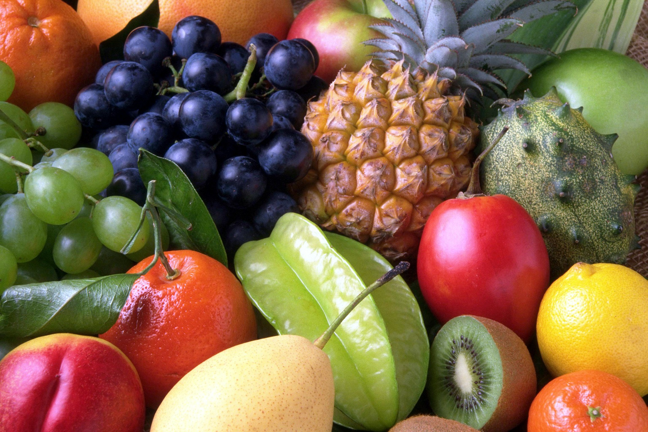
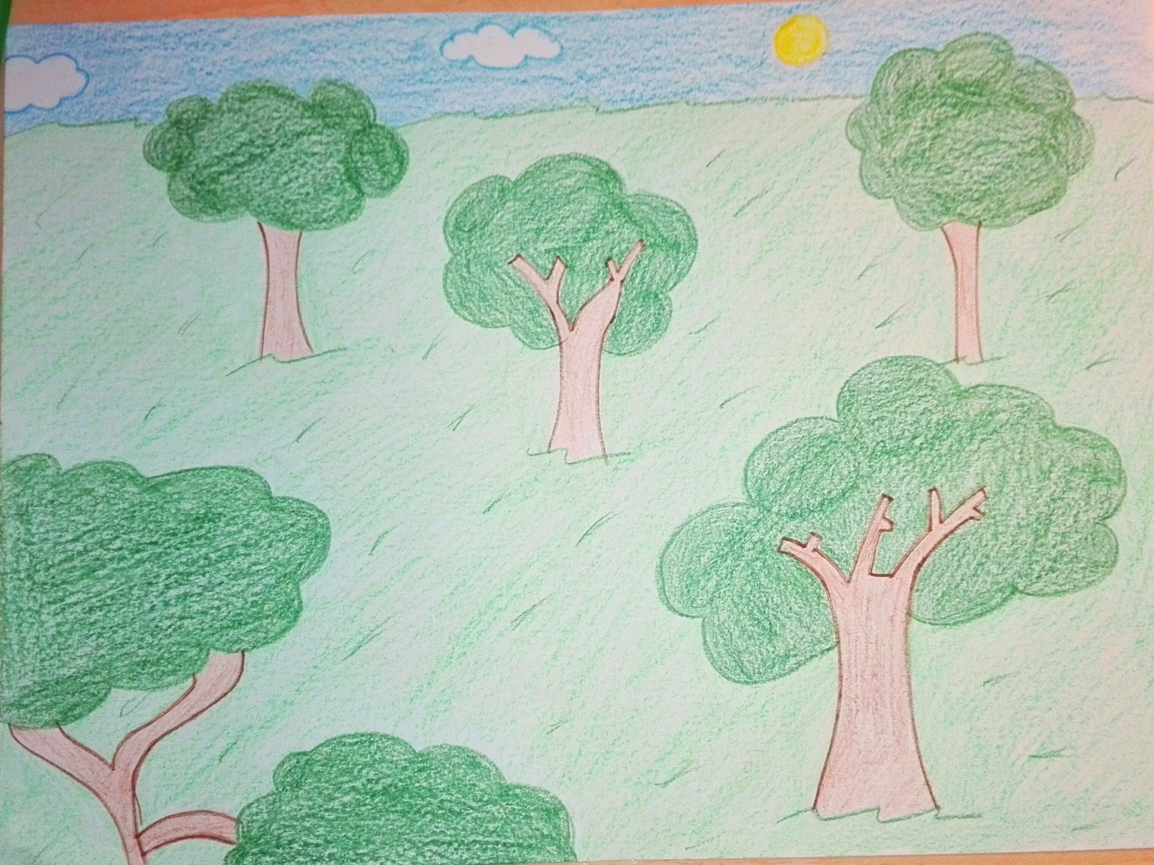

Slide 3
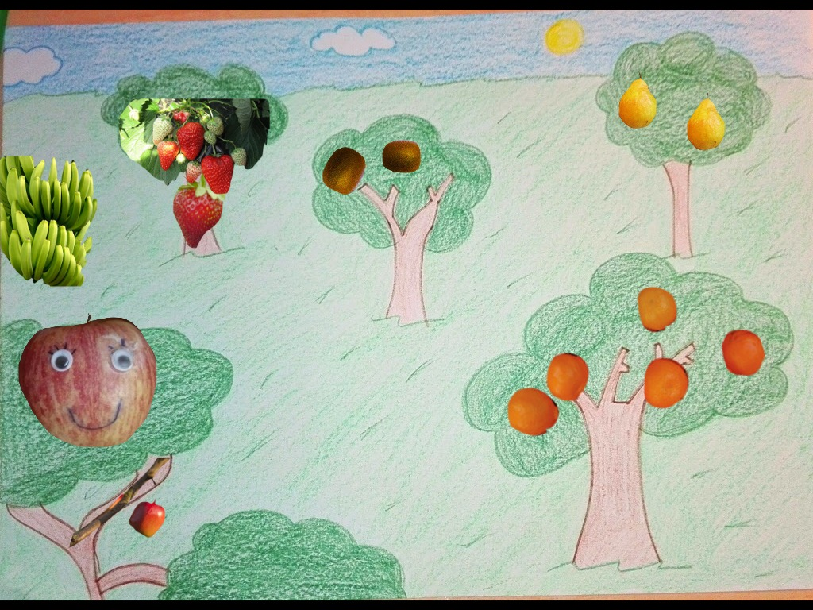

Slide 4
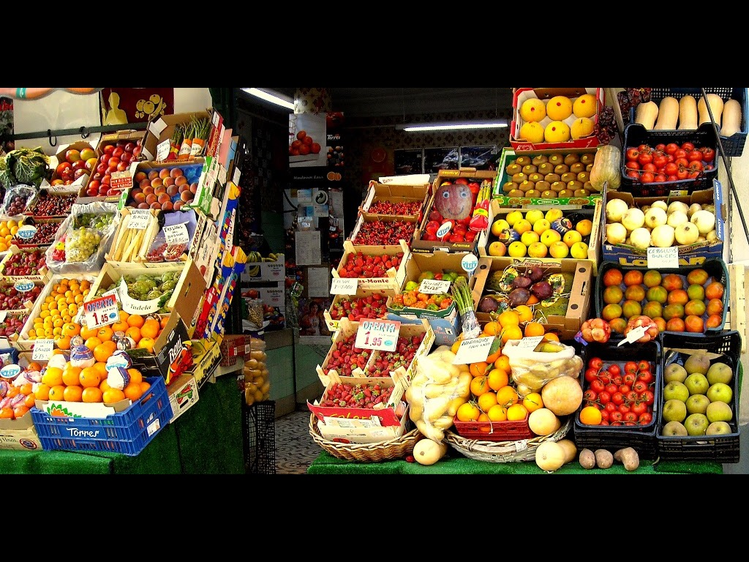

Slide 5
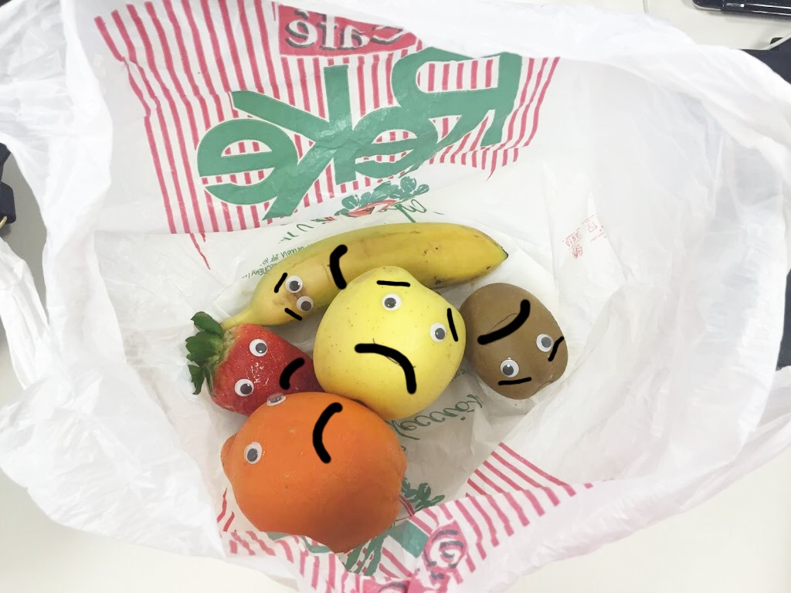

Slide 6
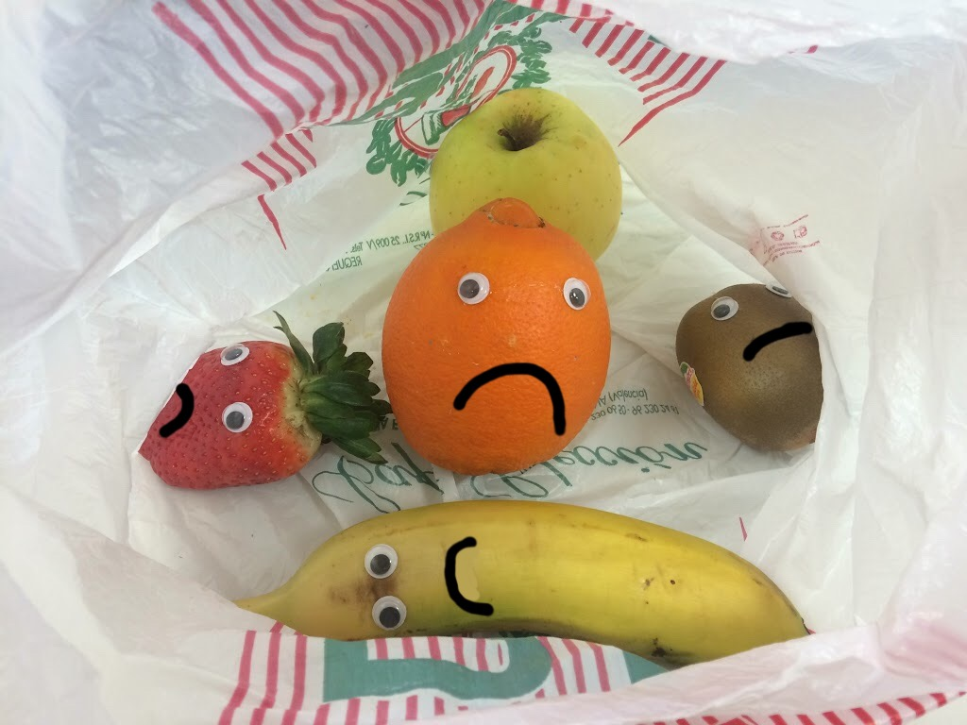

Slide 7
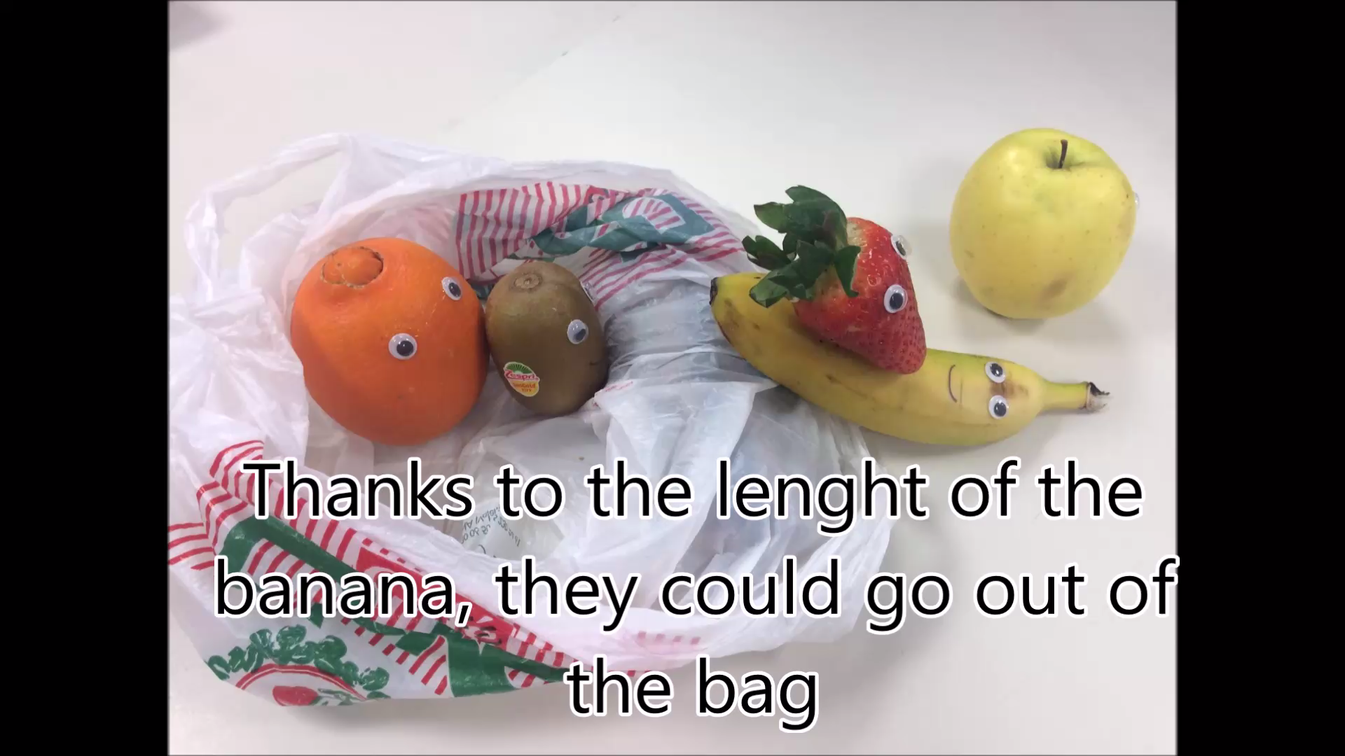

Slide 8
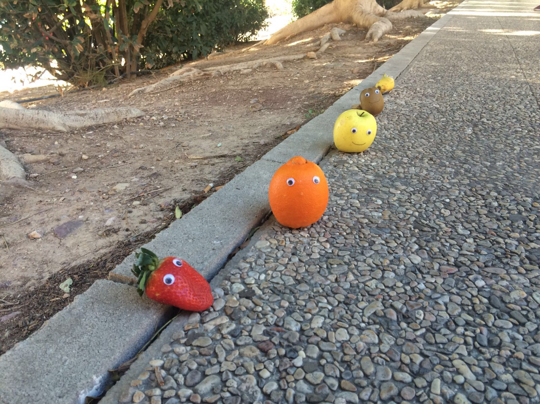
If we’re so amazing by ourselves, individually…
Just think on how strong we would be if we worked together

Slide 9
REFLECTION
Do you usually talk to different people?
What do you think about the orange’s behaviour?
What would have you done in that situation?

