Slide 1
PRESENTATIONS AND CREATIVE COMMON LICENSES

Slide 2
Prepare your presentation
Start with the end in mind
Talk only about the most important things.
Know your audience as well as possible:
priorities, level of intelligence…
image with CC0 Public Domain

Slide 3
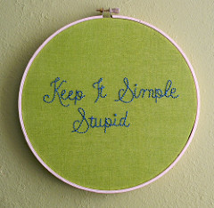
Use content from a reliable source.
Keep it simple
But not easy or stupid.
image from Hey Paul Studios https://goo.gl/myTFpA

Slide 4
the most important ideas.
design and content
Sound and clear structure
Summarize

Slide 5
Elevator test
Try saying the principal meanings above
30-45 minutes.
If we can do it, we can say it in a good way
to our public.

Slide 6
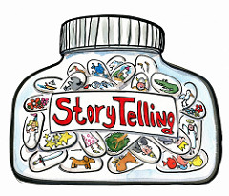
The art of storytelling:
Telling a real story helps public to understand it better, because then they will remember it.
Confidence - how to get it?
lear ideas
image from Frits Ahlefeldt-Laurvig https://goo.gl/mu09of
Prepare the exposition
Speak properly

Slide 7
Design your presentation
Simple
Not too much text
The star is the audience
Not long list of items

Slide 8
Don’t use a lot of animation
High quality images
Take into account copyrights.
image with CC0 Public Domain

Slide 9
Use an inusual template to catch the attention of the audience.
Use appropriate charts
image with CC0 Public Domain PublicDomainPictures / 18043 imágenes

Slide 10
Use color well Some colors stand out more than others
Choose your fonts well.
The slides must be read from everywhere.
Use just one type of font

Slide 11
Use video or audio to show examples
image with CC0 Public Domain OpenClipartVectors / 23290 imágenes image with CC0 Public Domain presidentofspace / 49 imágenes
Spend time in the slide sorter. If the audience see more than one slide, they will follow better the logic of the presentation.

Slide 12
Deliver your presentation
Show to the audience your enthusiasm and passion about the topic your are talking about.
image with CC0 Public Domain geralt / 11177 imágenes
Start strong. It is also essential to catch the attention of the public in the first 2-3 minutes.

Slide 13
Keep it short
Move away from the podium
Eye contact
Keep lights on

Slide 14
General
Structure your presentation like a story
Three parts
Introduce your topic
Develop the middle
Make the end powerful

Slide 15
Creative Common
Is a non-profit organization devoted to expanding the range of creative works available for others to build upon legally and to share.
This organization has released several copyright-licenses known as Creative Commons Licenses free of charge to the public.
Image from: copyrightfreepictures/203imagen
These licenses allow creators to communicate
which rights they reserve,and which rights they
waive for the benefit of recipients or other creators.

Slide 16
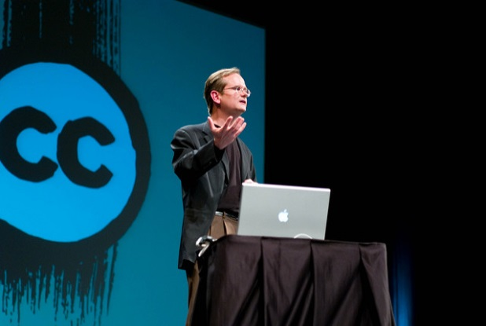
Founded: 2001, 15 years ago
Founder: Lawrence lessig
Focus: Expansion of “reasonable”,
flexible copyright.
Method: Creative commons license.
Website: creativecommons.org
imagesfrom : flickr , authors: Jai to and AJC ajcann

Slide 17
“CREATIVE COMMONS HELPS YOU SHARE YOUR KNOWLEDGE AND CREATIVITY WITH THE WORLD.”
Image from: flickr ,by gwynethJones

Slide 18
Atribution
Others can copy, distribute, display,perform and remix your work if they credit your name as requested by you.
No Derivate works
Others can only copy, distribute, display or perform verbatim copies of your work.
Share alike
Others can distribute your work only under a license identical to the one you have you have choosen for your work.
Non- comercial
Others can copy, distribute, display, remix or perform your work but for non-commercial purposes only.
images from pixaby, copyrightfreepictures/203images CCO public domain

Slide 19
Image from: esmasternewmedia.org . This image is under a Creative Commons license

Slide 20
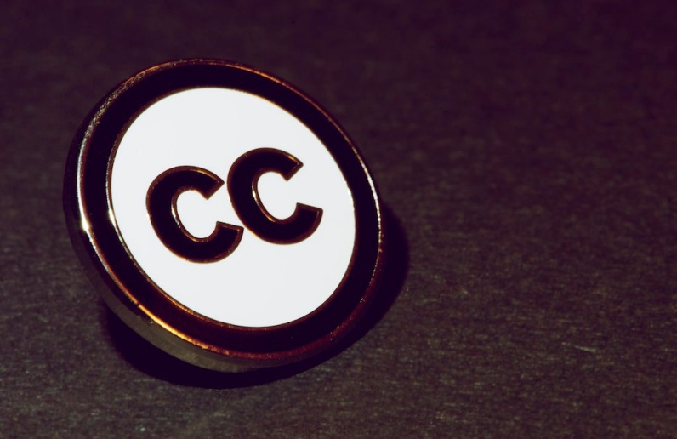
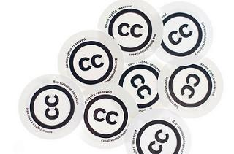
Creative commons
Creative commons has been described as being at the forefront of the copyleft movement which seeks to support the building of a richer public domain by providing an alternative to the automatic
“all rights reserved” copyright and has been dubbed “some right researches”
Images from flickr by kristina alexanderson

Slide 21
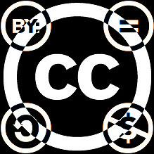
Criticism to creative commons
All current CC licenses ( except the CC0 Public Domain Dedication tool) require attribution, which can be inconvenient for works.
Critics worried that the lack of rewards for content producers will dissuade artists from publishing their work.
Image from: flickr, by Joyel Aheranm

